Slide 1



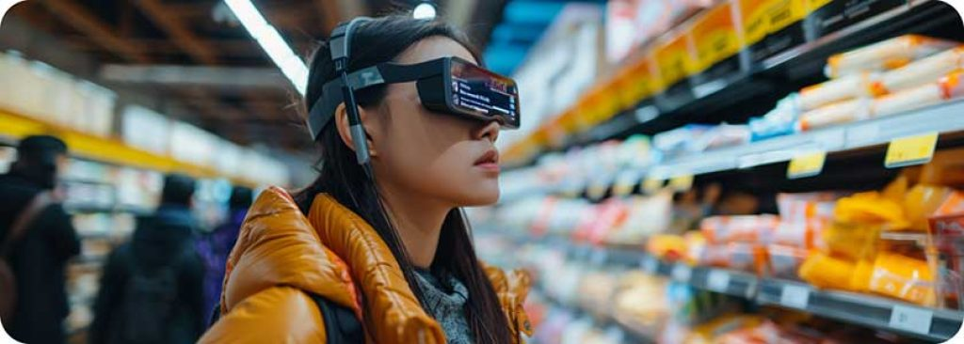

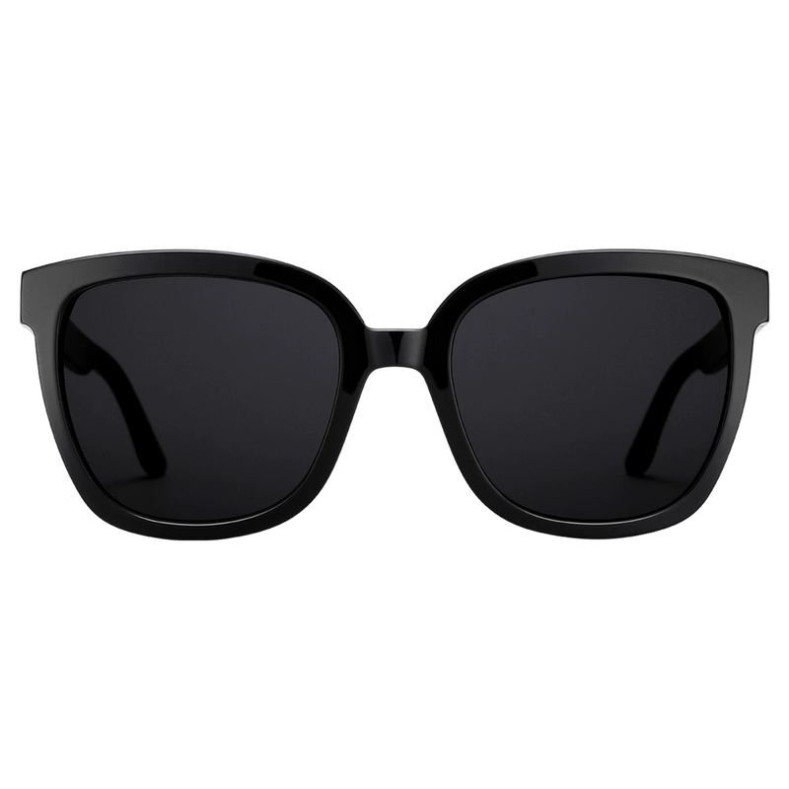

ENHANCING LIVES THROUGH INNOVATIVE TECHNOLOGY
VISION BEYOND SIGHT
Real-Time Object Detection and Speech Feedback System for Visually Impaired Individuals

Slide 2
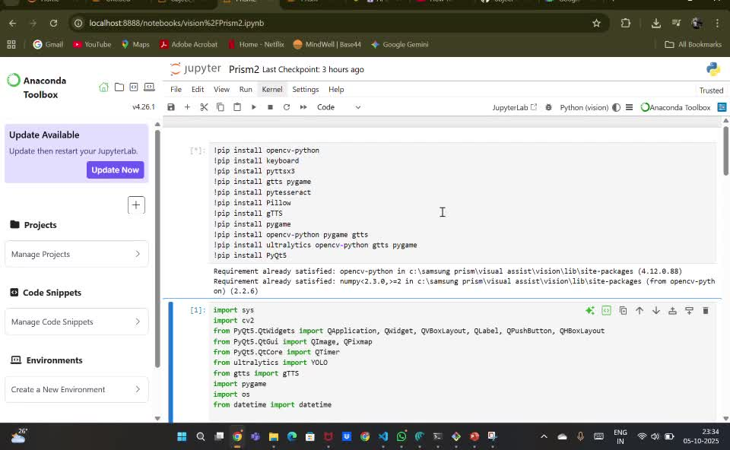
TEAM NAME : SWORD OF MORNING
GITHUB LINK:https://github.com/Rivu5555/object-whisperer.git
THEME SELECTED : AI in HealthTech
TEAM MEMBERS
Tufan Layek (RA2411004010209)
Protyay Saha (RA2411004010196)
Adamya Srivastava (RA2411004010190)

Slide 3


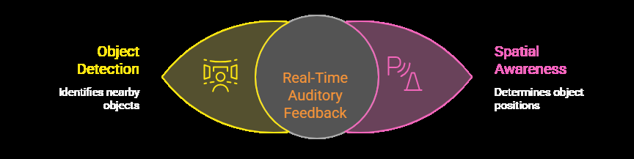
INTRODUCTION
Visually impaired individuals encounter significant obstacles in their daily lives, particularly when navigating unfamiliar environments. While traditional assistive technologies like white canes have been helpful, they offer limited information about the surroundings. Smart glasses, although more advanced, are often prohibitively expensive. Furthermore, many existing systems focus primarily on text recognition, neglecting the crucial aspect of real-time obstacle detection and spatial awareness.
Our proposed solution addresses these shortcomings by integrating object detection and spatial awareness into a text-to-speech system. This enhanced system provides real-time auditory feedback about nearby objects and their positions, enabling visually impaired users to navigate more safely and independently.

Slide 4
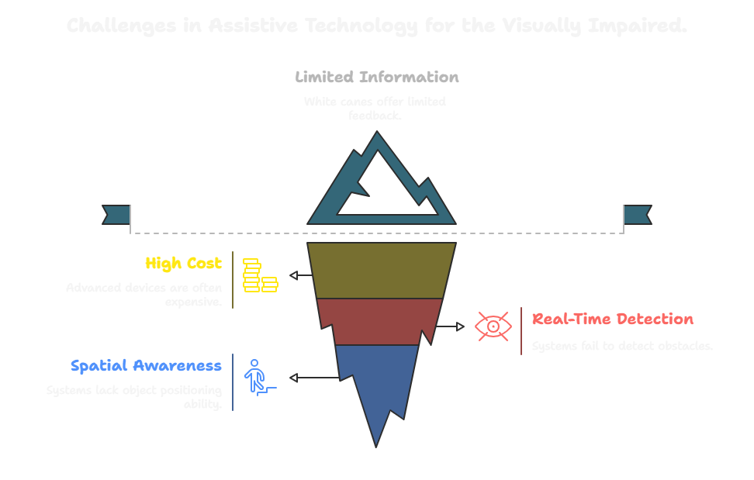
PROBLEM STATEMENT
The core problem lies in the lack of affordable and comprehensive assistive technologies that provide visually impaired individuals with real-time information about their surroundings.

Slide 5
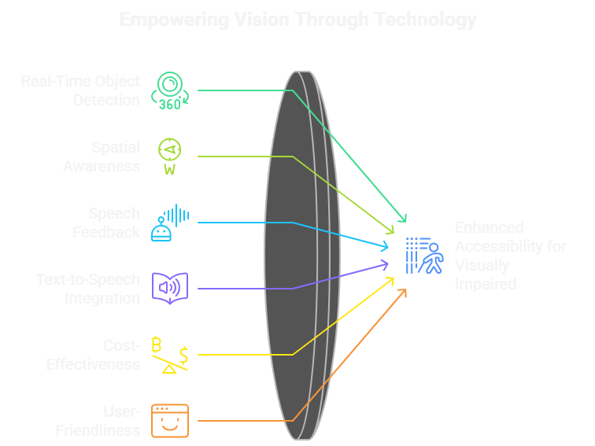
PROPOSED SOLUTION
Our proposed solution involves an enhanced text-to-speech model that incorporates object detection and spatial awareness capabilities. The system utilizes a camera to continuously scan the surroundings, detect nearby objects, and determine their relative position (left, right, or front). This information is then instantly converted into speech output, providing users with real-time alerts about obstacles and their positions.

Slide 6
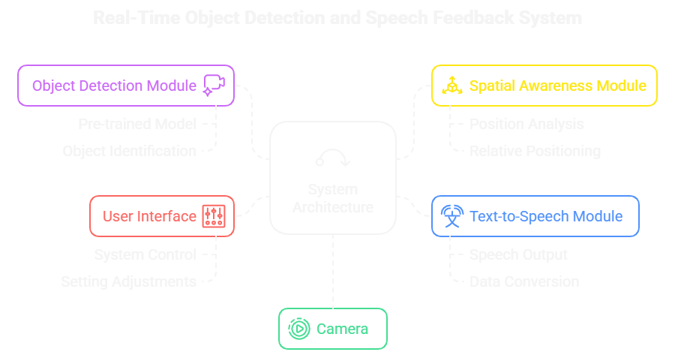
SYSTEM ARCHITECTURE

Slide 7
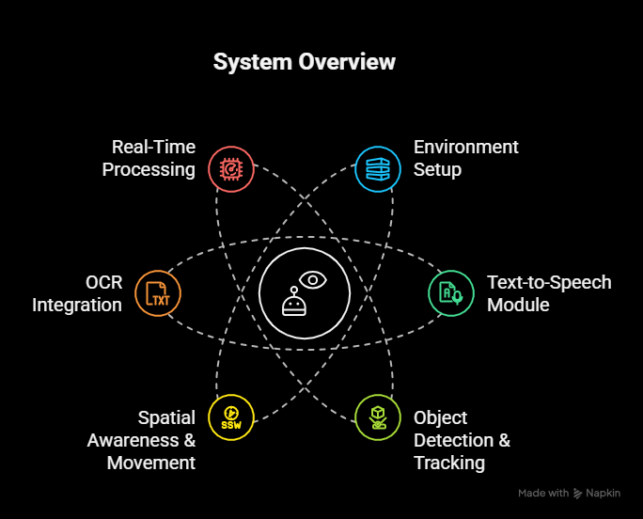
IMPLEMENTATION
Libraries & Models: YOLOv8 for object detection, OpenCV for video, Pytesseract for OCR, Pyttsx3 for TTS.
Object Detection: Camera captures live feed → YOLOv8 detects objects → bounding box size estimates distance (close/medium/far).
Tracking & Movement: Each object assigned ID → centroid tracked → direction & speed calculated → speech alerts given at intervals.
Text Reading (OCR): If a book is detected, text is extracted via Pytesseract and spoken aloud.
Speech Output: Non-blocking TTS thread converts detections into clear real-time audio feedback.
Performance: Runs ~30 FPS, real-time with visual + speech output.

Slide 8

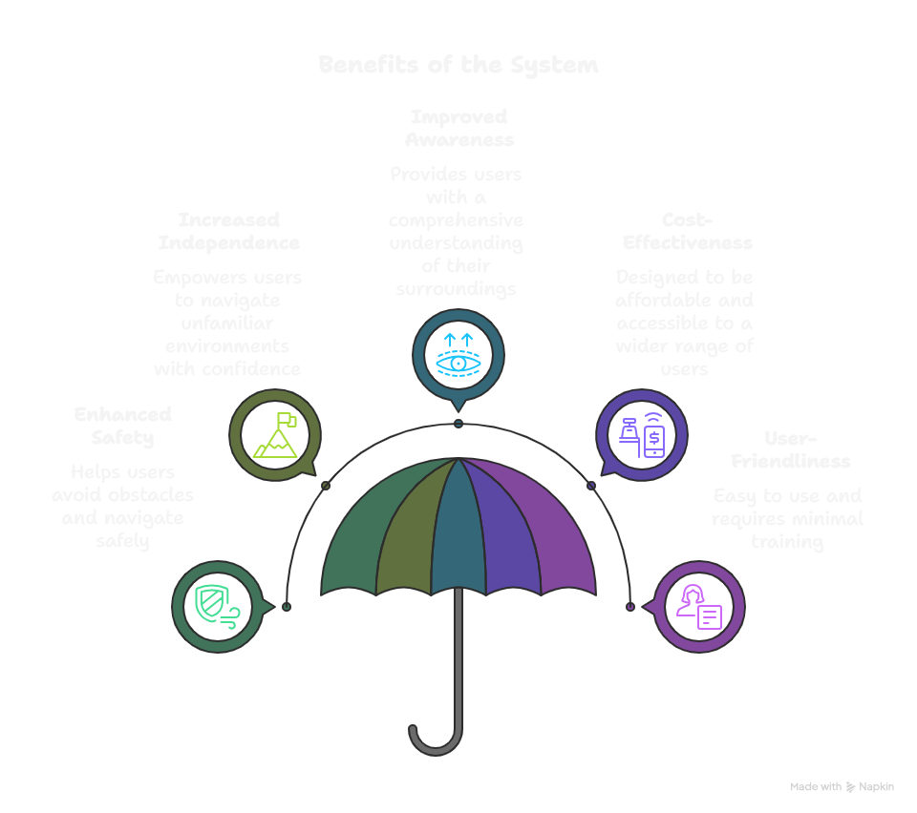



Slide 9
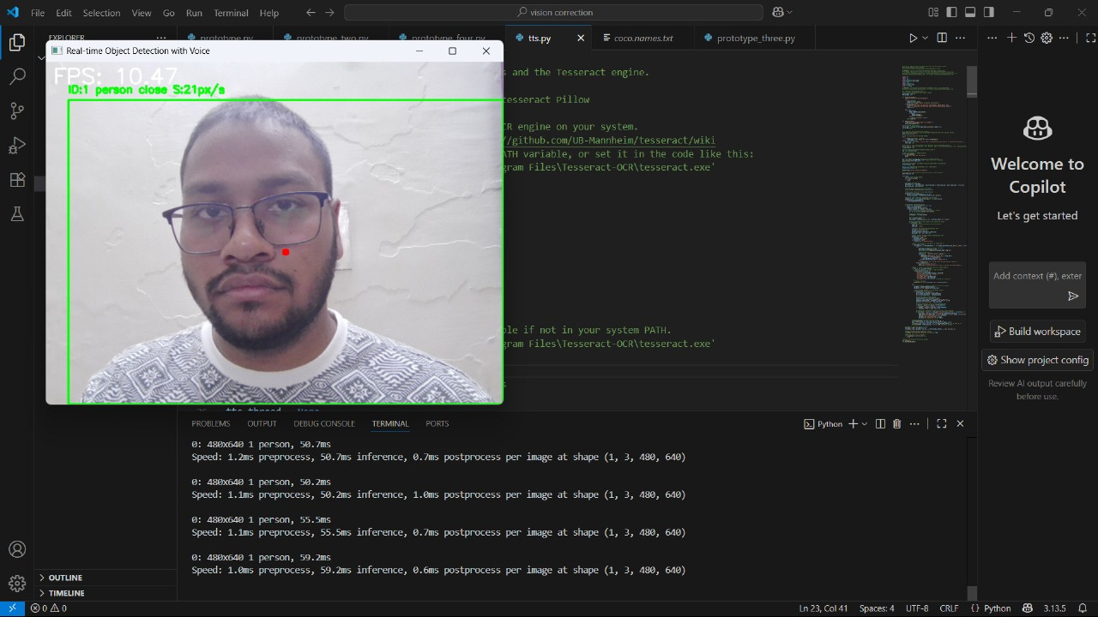
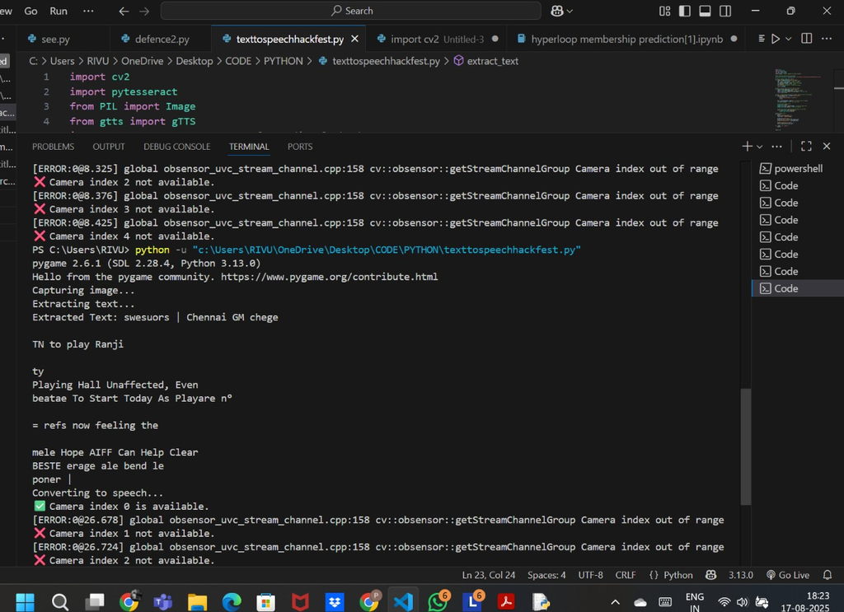
PROTOTYPE
Image recognition
Text to speech

Slide 10
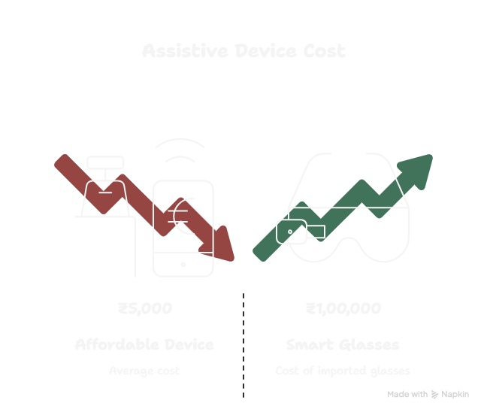
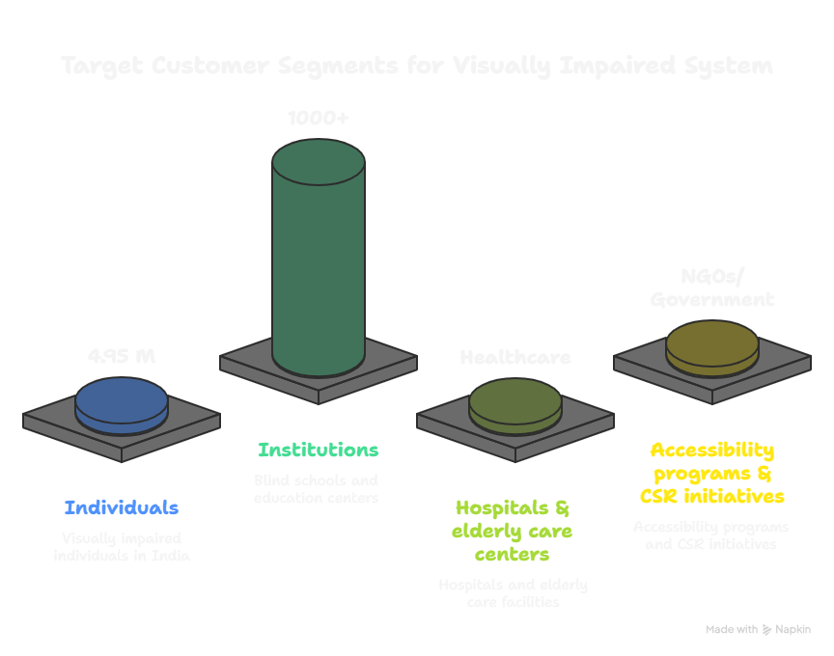
BUSINESS MODEL
Value Proposition
2. Customer Segments

Slide 11
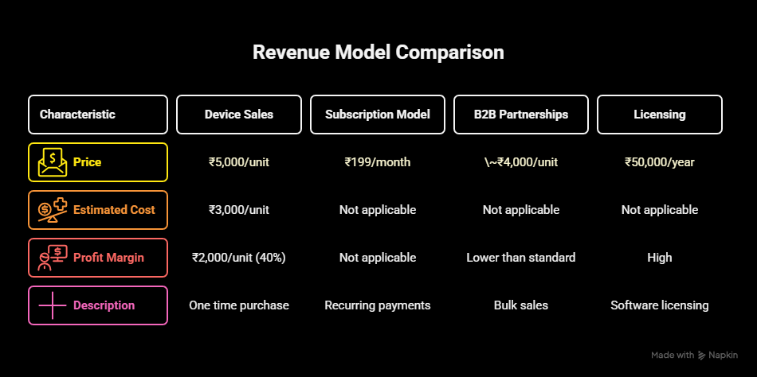
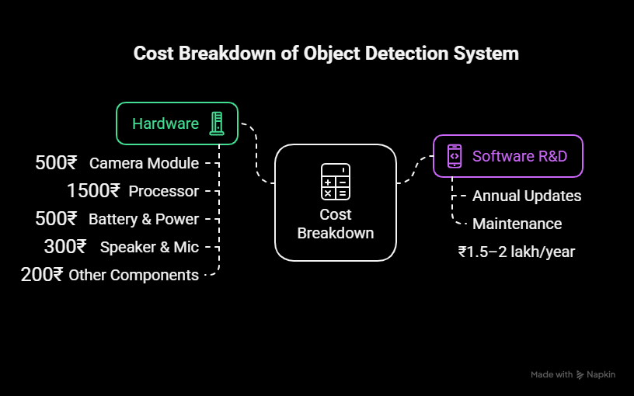
3. Revenue Streams
4. Key Resources (Cost Estimates)

Slide 12
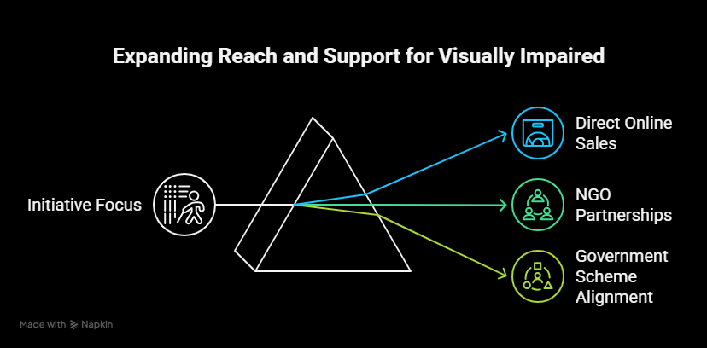
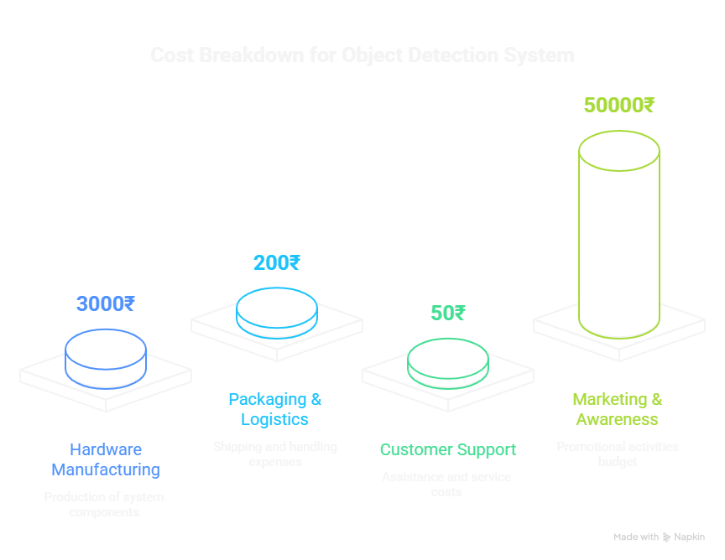
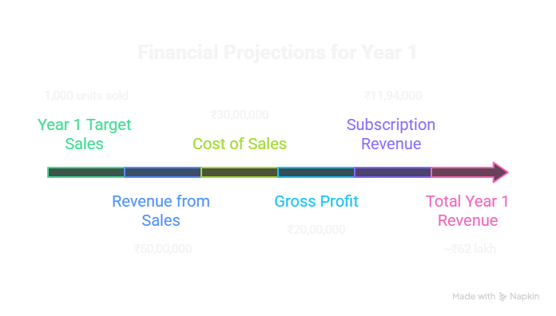
5. Distribution Channels
6. Cost Structure
7. Financial Projection (Example)

Slide 13
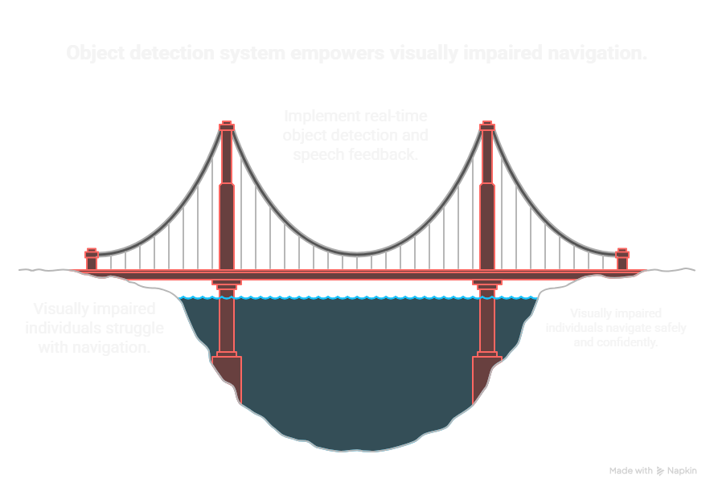
CONCLUSION
The real-time object detection and speech feedback system presented in this document offers a promising solution to the challenges faced by visually impaired individuals in navigating their surroundings. By combining object detection, spatial awareness, and speech feedback, the system provides users with the information they need to navigate safely and independently. The cost-effectiveness and user-friendliness of the system make it a viable alternative to existing assistive technologies, potentially improving the lives of countless visually impaired individuals. Further research and development will focus on refining the object detection model, improving the accuracy of spatial awareness, and enhancing the user interface to create a truly seamless and effective assistive tool.

Slide 14
Thank You

